Slide 1
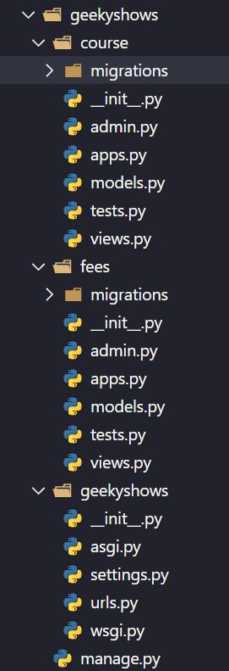
URL Pattern
URL Pattern inside Project
views.py of course
from django.http import HttpResponse
def learn_django(request):
return HttpResponse(‘Hello Django’)
views.py of fees
from django.http import HttpResponse
def fees_django(request):
return HttpResponse(‘300’)
urls.py
from course import views as cv
from fees import views as fv
urlpatterns = [
path(‘learndj/’, cv.learn_django),
path(‘feesdj/’, fv.fees_django),
]

Slide 2
Why URL Pattern inside Application
So far we have learnt to define url pattern at project level for our all application.
This approach increases the dependency of applications in project which means if we want to use a particular application for our another project we may face issues.
Our each application should be independent or less depend on project so we could use our applications in different projects easily without worrying about urls.py available in Project Folder.
Following are the benefits of defining url pattern inside Application
Reduces the dependency of Application
Enhance Application performance.
Reusability of application becomes easy.

Slide 3
include ( )
A function that takes a full Python import path to another URLconf module that should be “included” in this place.
Optionally, the application namespace and instance namespace where the entries will be included into can also be specified.
include() also accepts as an argument either an iterable that returns URL patterns or a 2-tuple containing such iterable plus the names of the application namespaces.
urlpatterns can “include” other URLconf modules.
Syntax:-
include(module, namespace=None)
include(pattern_list)
include((pattern_list, app_namespace), namespace=None)
Where,
module – URLconf module (or module name)
namespace (str) – Instance namespace for the URL entries being included
pattern_list – Iterable of path() and/or re_path() instances.
app_namespace (str) – Application namespace for the URL entries being included

Slide 4
include ( )
Syntax:-
include(module, namespace=None)
include(pattern_list)
include((pattern_list, app_namespace), namespace=None)
Example:-
from django.urls import include, path
urlpatterns = [
path(‘cor/', include(‘course.urls')),
]
urlpatterns = [
path(‘cor/', include([
path(‘learndj/’, views.learn_django),
path(‘learnpy/’, views.learn_python)
])),
]
path(route, view, kwargs=None, name=None)
The view argument is a view function or the result of as_view() for class-based views. It can also be an django.urls.include().
otherpatterns = [
path(‘learndj/’, views.learn_django),
path(‘learnpy/’, views.learn_python),
]
urlpatterns = [
path(‘cor/', include(otherpatterns),
]

Slide 5
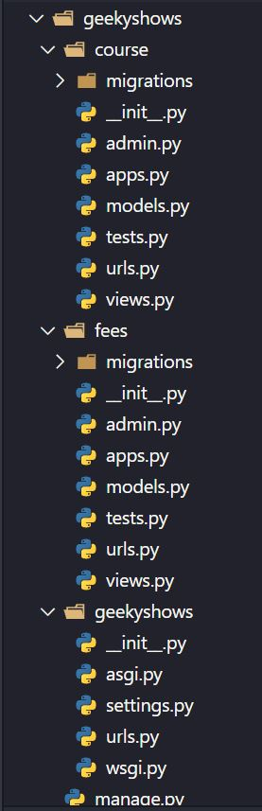
Write URL Pattern inside Application
Create an urls.py file inside each application (in case multiple application).
Write all url pattern related to application, in urls.py file available inside application.
Include Application’s urls.py file inside Project’s urls.py file.
views.py in Application Folder
from django.http import HttpResponse
def learn_django(request):
return HttpResponse(‘Hello Django’)
def learn_python(request):
return HttpResponse(‘<h1>Hello Python</h1>’)
urls.py in Application Folder
from course import views
urlpatterns = [
path(‘learndj/’, views.learn_django),
path(‘learnpy/’, views.learn_python),
]
urls.py in Project Folder
from django.urls import path, include
urlpatterns = [
path(‘cor/’, include(‘course.urls’)),
]
Package Name
Module Name
http://127.0.0.1:8000/cor/learndj
http://127.0.0.1:8000/cor/learnpy

Slide 6
Geeky Steps
Create Django Project: django-admin startproject geekyshows
Change Directory to Django Project: cd geekyshows
Create Django Application: python manage.py startapp course
Add/Install Application to Django Project using settings.py file INSTALLED_APPS
Write View Function inside views.py file
Create an urls.py file inside each application (in case multiple application).
Write all url pattern related to application, in urls.py file available inside application.
Include Application’s urls.py file inside Project’s urls.py file.

